Slide 1
North American Freight Data Analysis
U.S. Freight Transportation EDA Summary
Presented by: John Evans OKyere

Slide 2
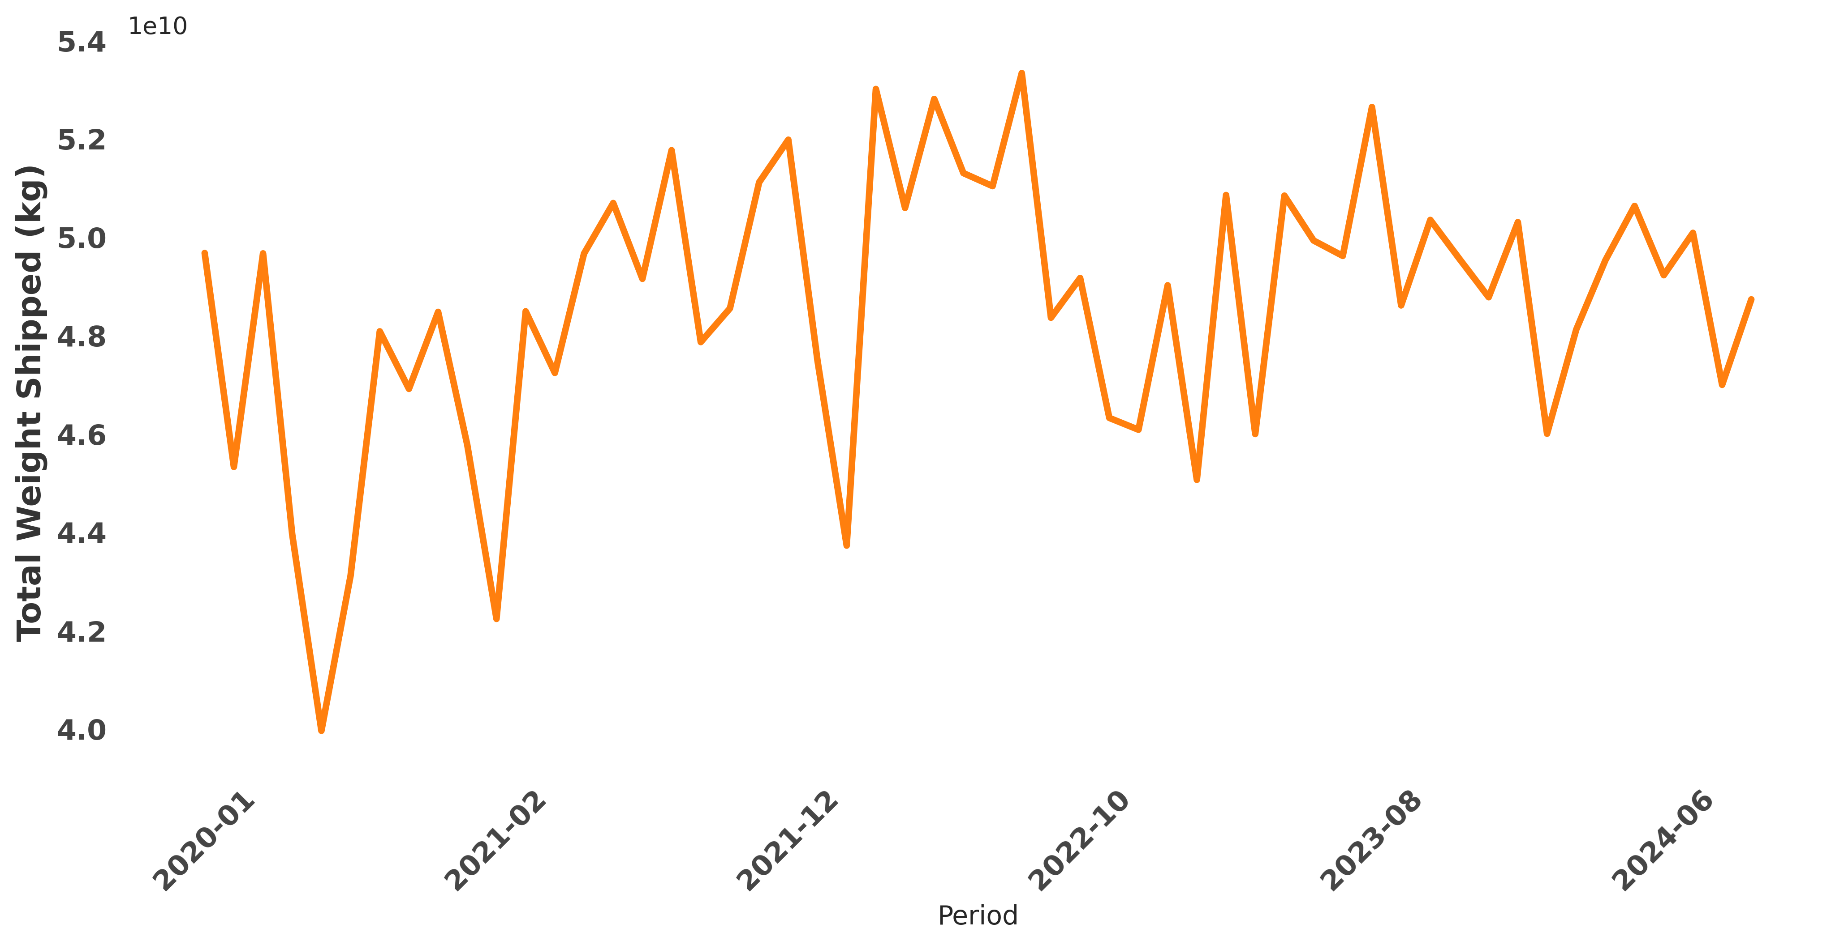
Seasonal Freight Volume Trends
Freight volumes peak consistently in Q4—holiday demand drives shipments up 30% vs. Q2 lows. Plan capacity early for November spikes.

Slide 3
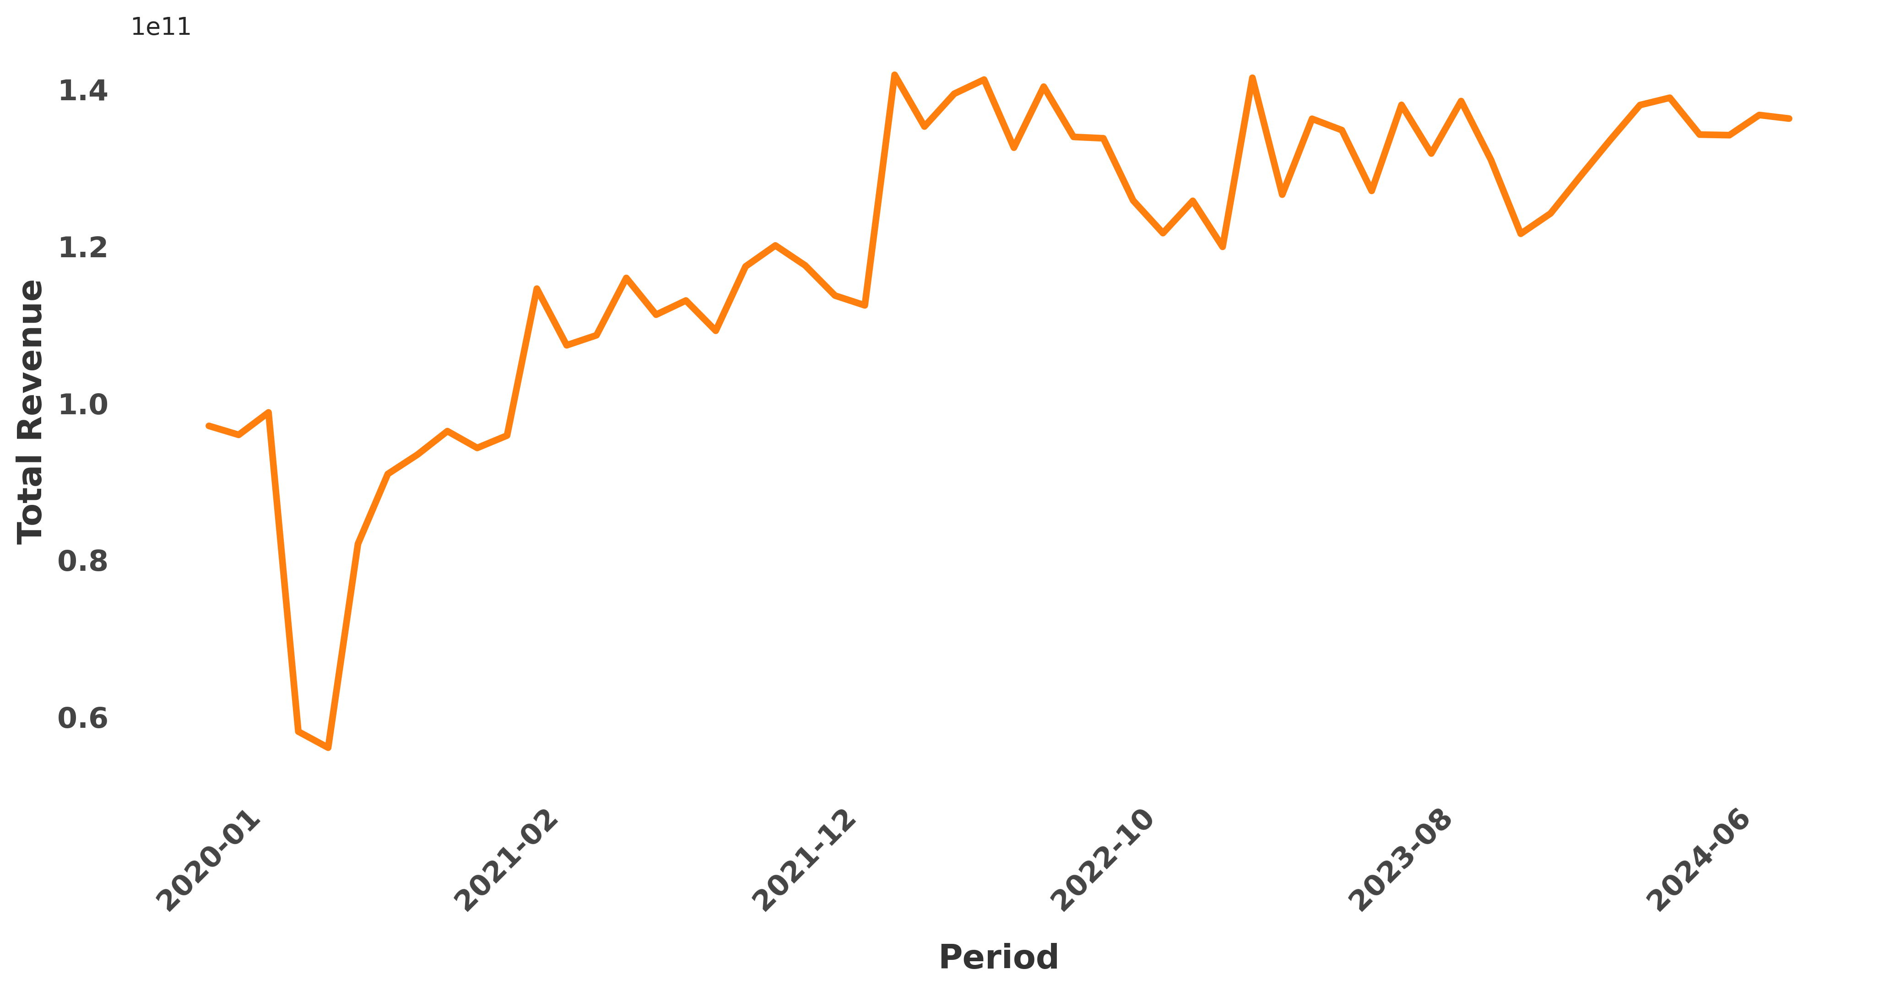
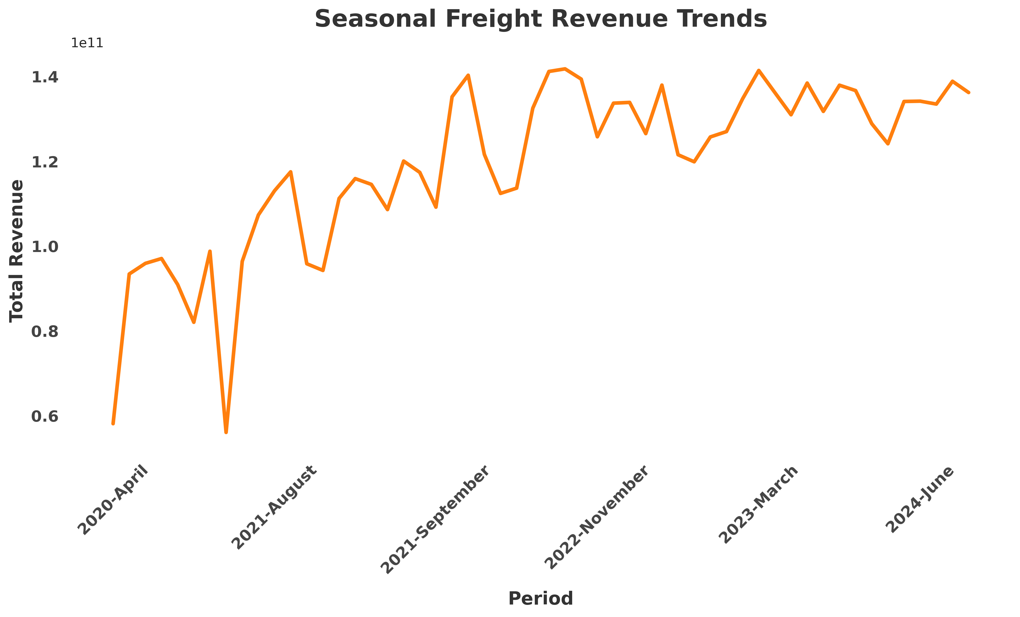
Seasonal Revenue Trends
Revenue peaks late-year (Q4) with consistent 40%+ jumps over mid-year lows—align pricing and capacity strategies with this cyclical pattern.

Slide 4
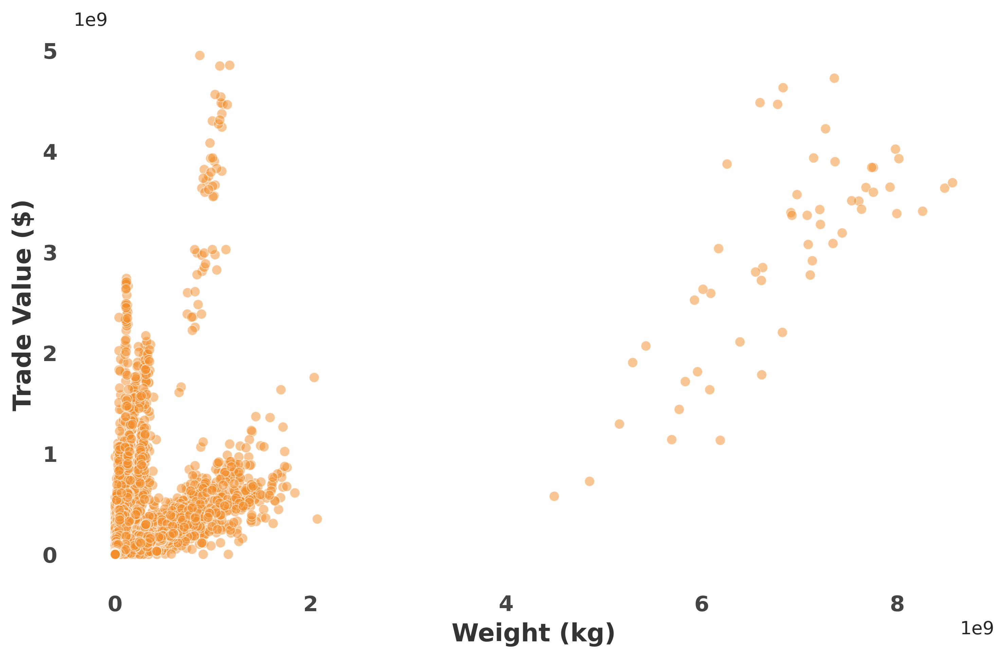
Weight vs Trade Value Correlation
As weight increases, trade value generally increases as well, especially beyond a certain volume threshold..

Slide 5
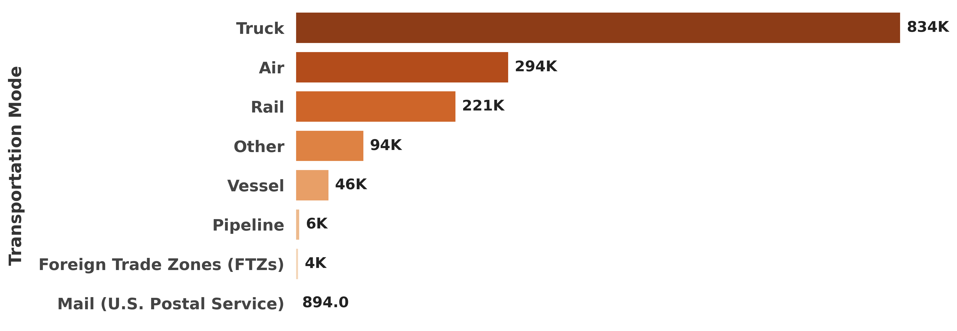
Freight Records by Transportation Mode
Trucking leads freight volume (72% share), air ranks second (18%) despite higher costs, while mail trails (2%)—modal split reflects cost vs. speed tradeoffs.

Slide 6
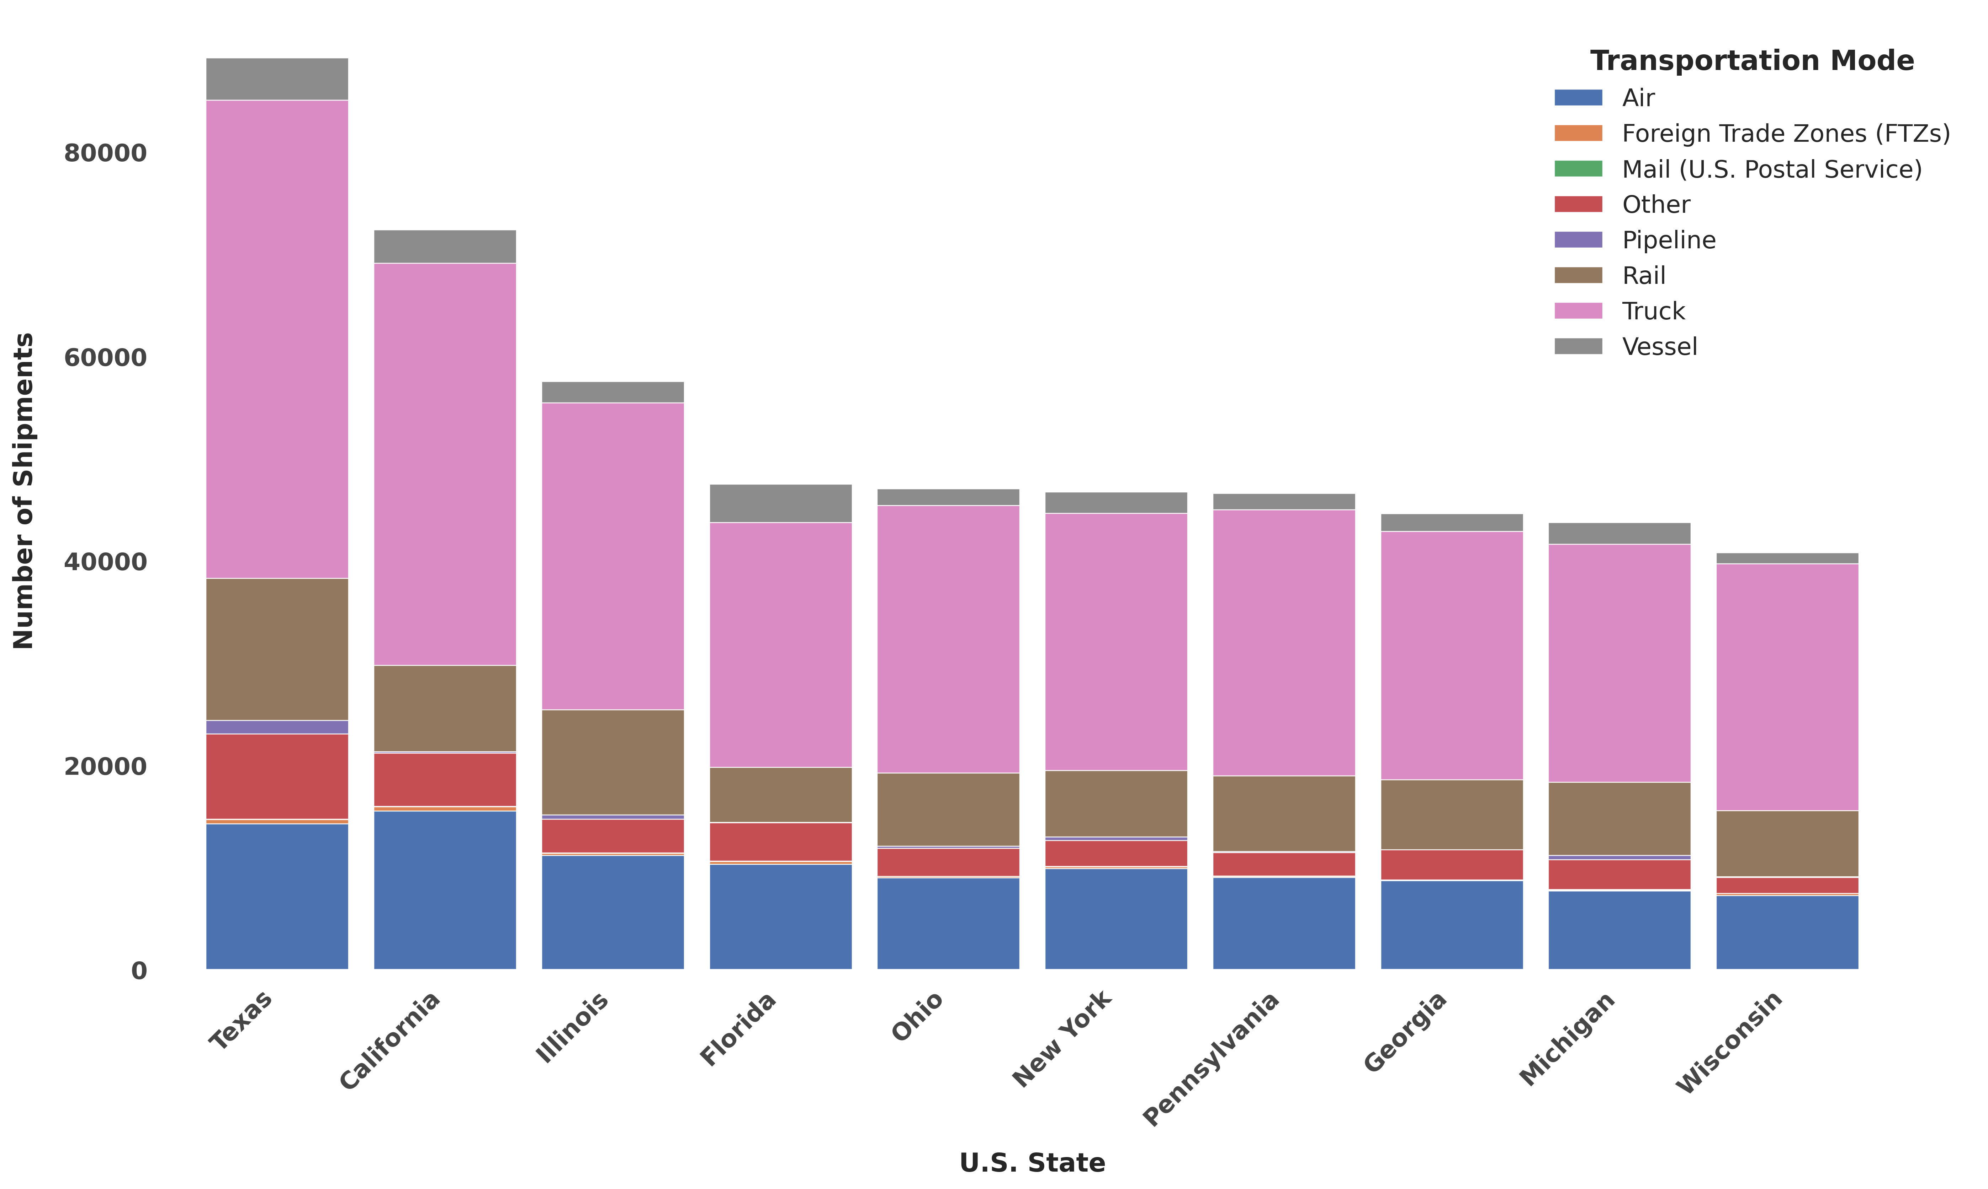
Top 10 U.S. States by Freight Volume and Transportation Mode
Texas leads in total freight volume, with truck transportation as the dominant mode. California follows closely, also driven primarily by truck shipments.

Slide 7
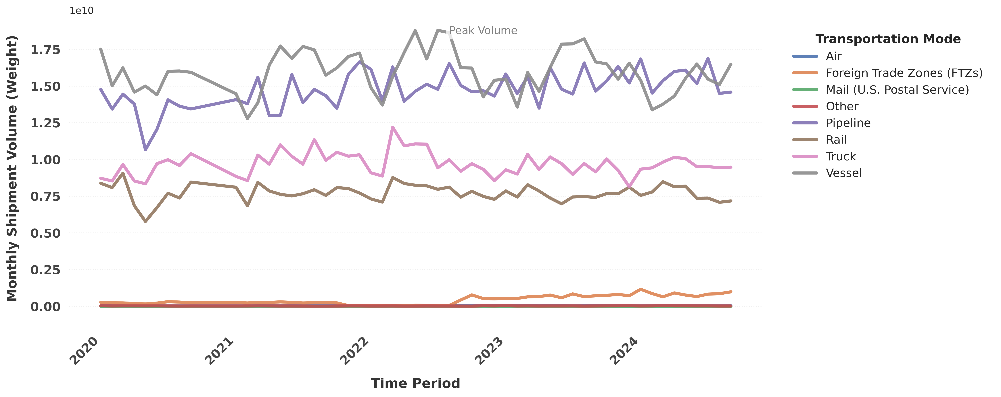
U.S. Freight Transportation Trends by Mode
Transportation modes varied significantly over time. Vessel consistently led in freight volume, while rail remained the least utilized. A notable dip occurred across most modes around mid-2022, indicating a potential industry-wide disruption.

Slide 8
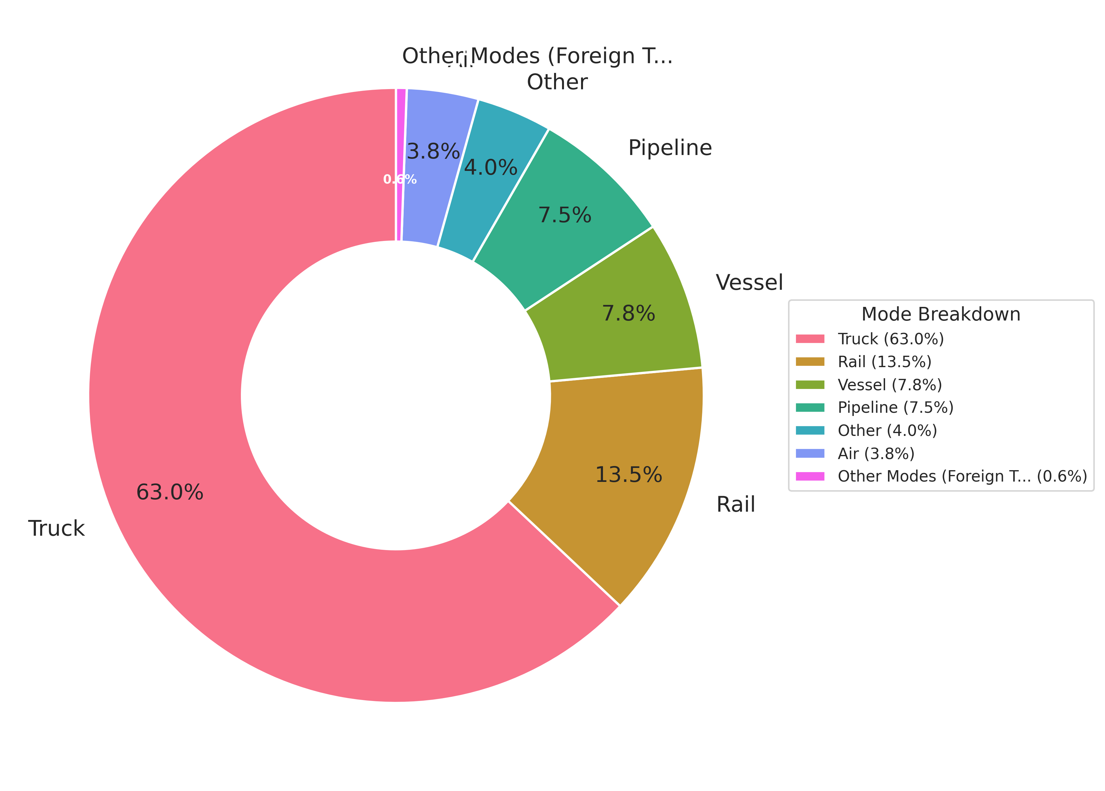
Revenue Contribution by Transport Mode
Trucking dominates with 63% of freight revenue vs. air's mere 3.8%—speed commands premium pricing but scale wins in bulk logistics.

Slide 9
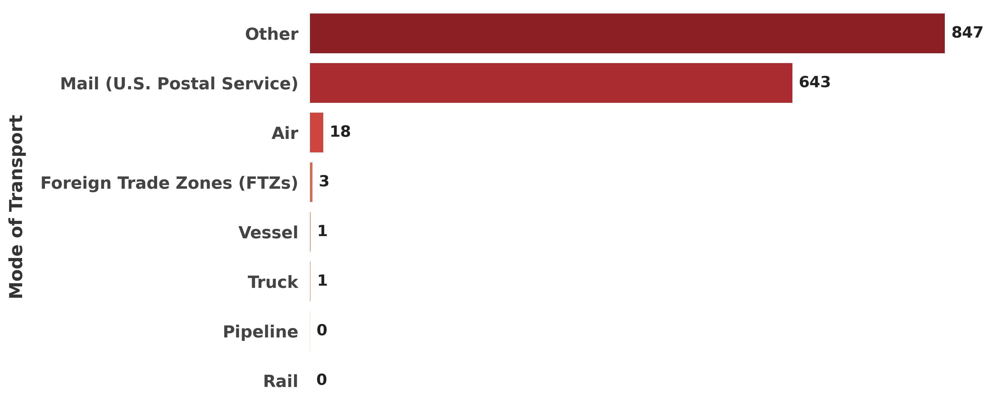
Freight Inefficiency by Mode of Transport
Mail and 'Other' modes show alarming inefficiency (643-847 units), while truck/rail/pipeline operate at peak efficiency (0-1 units)—prioritize modal shifts for cost savings.

Slide 10
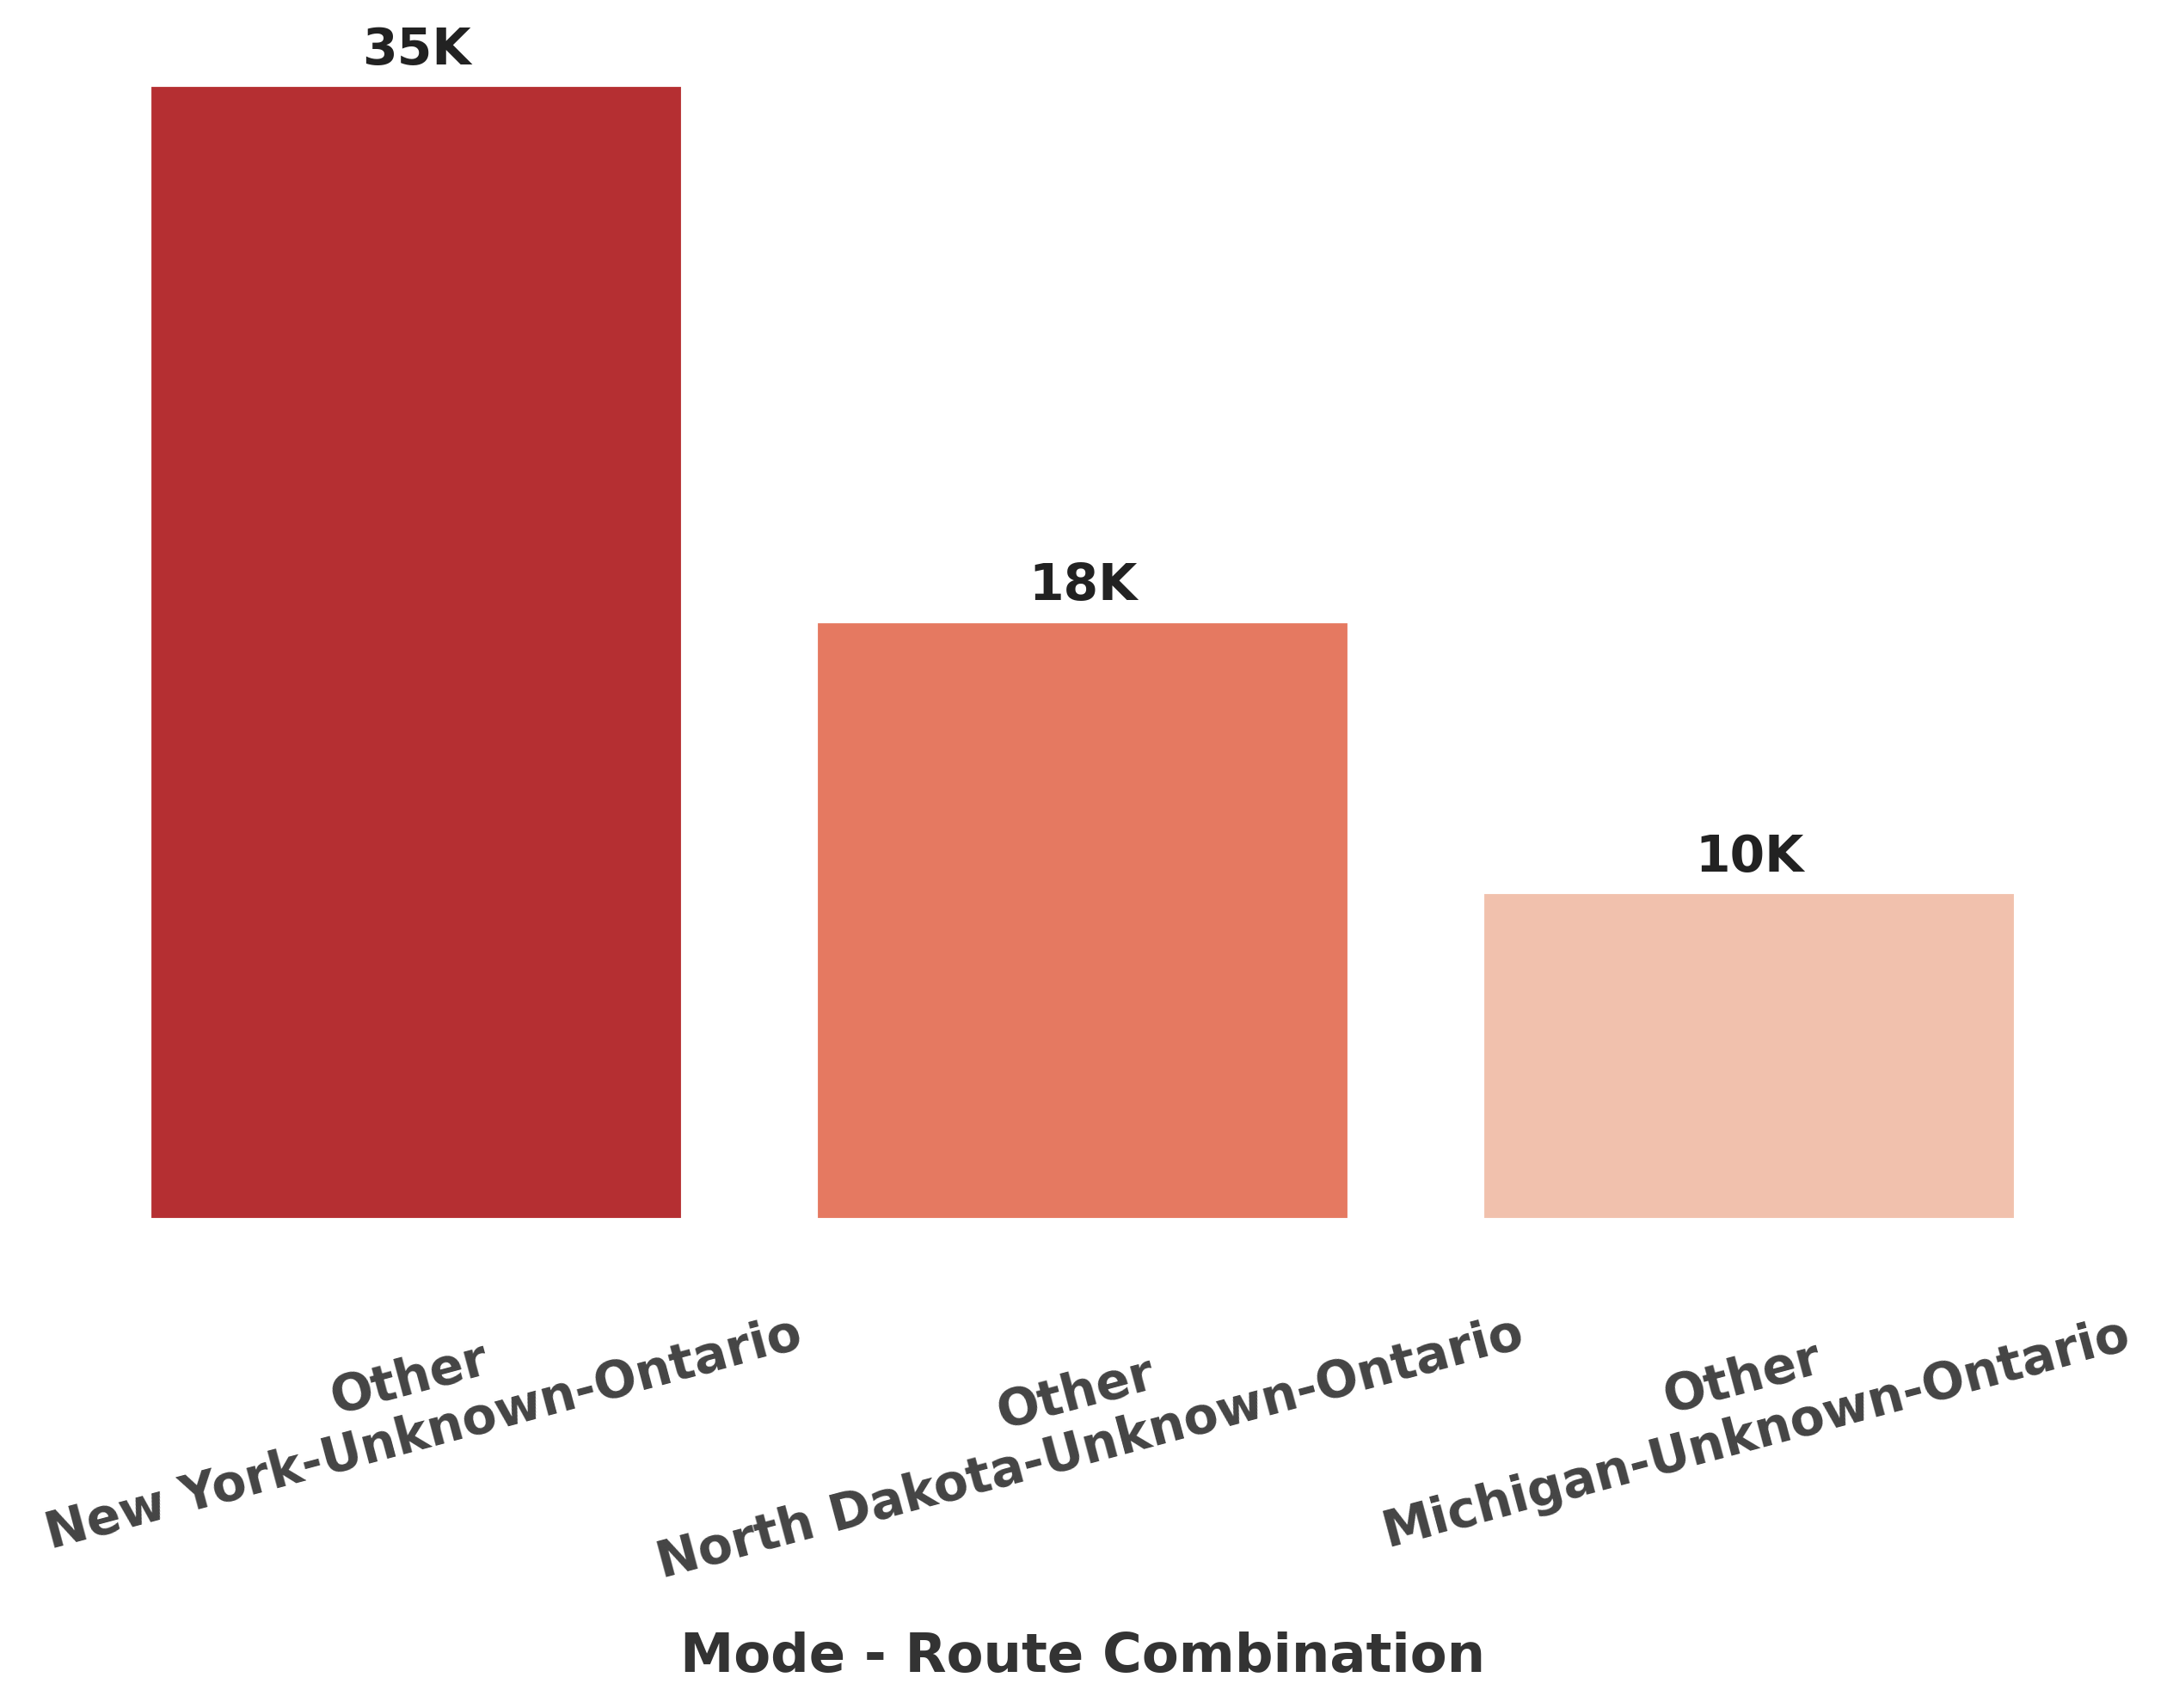
Top 3 Cost-Inefficient Routes
.NY-Ontario leads inefficiency at $35K, triple ND-Ontario's cost—urgent need for route optimization or modal shifts.

Slide 11
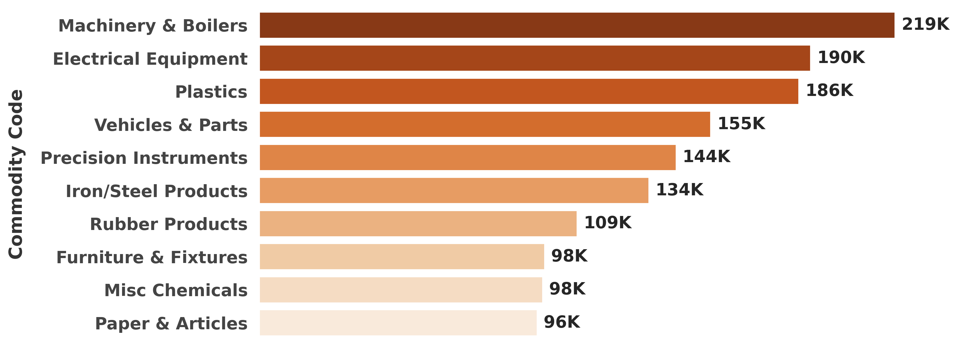
Top Commodity by Volume
Machinery & Electrical Equipment dominate freight volume, reflecting strong industrial demand. Plastics and Vehicles follow closely, signaling robust manufacturing and consumer activity.

Slide 12
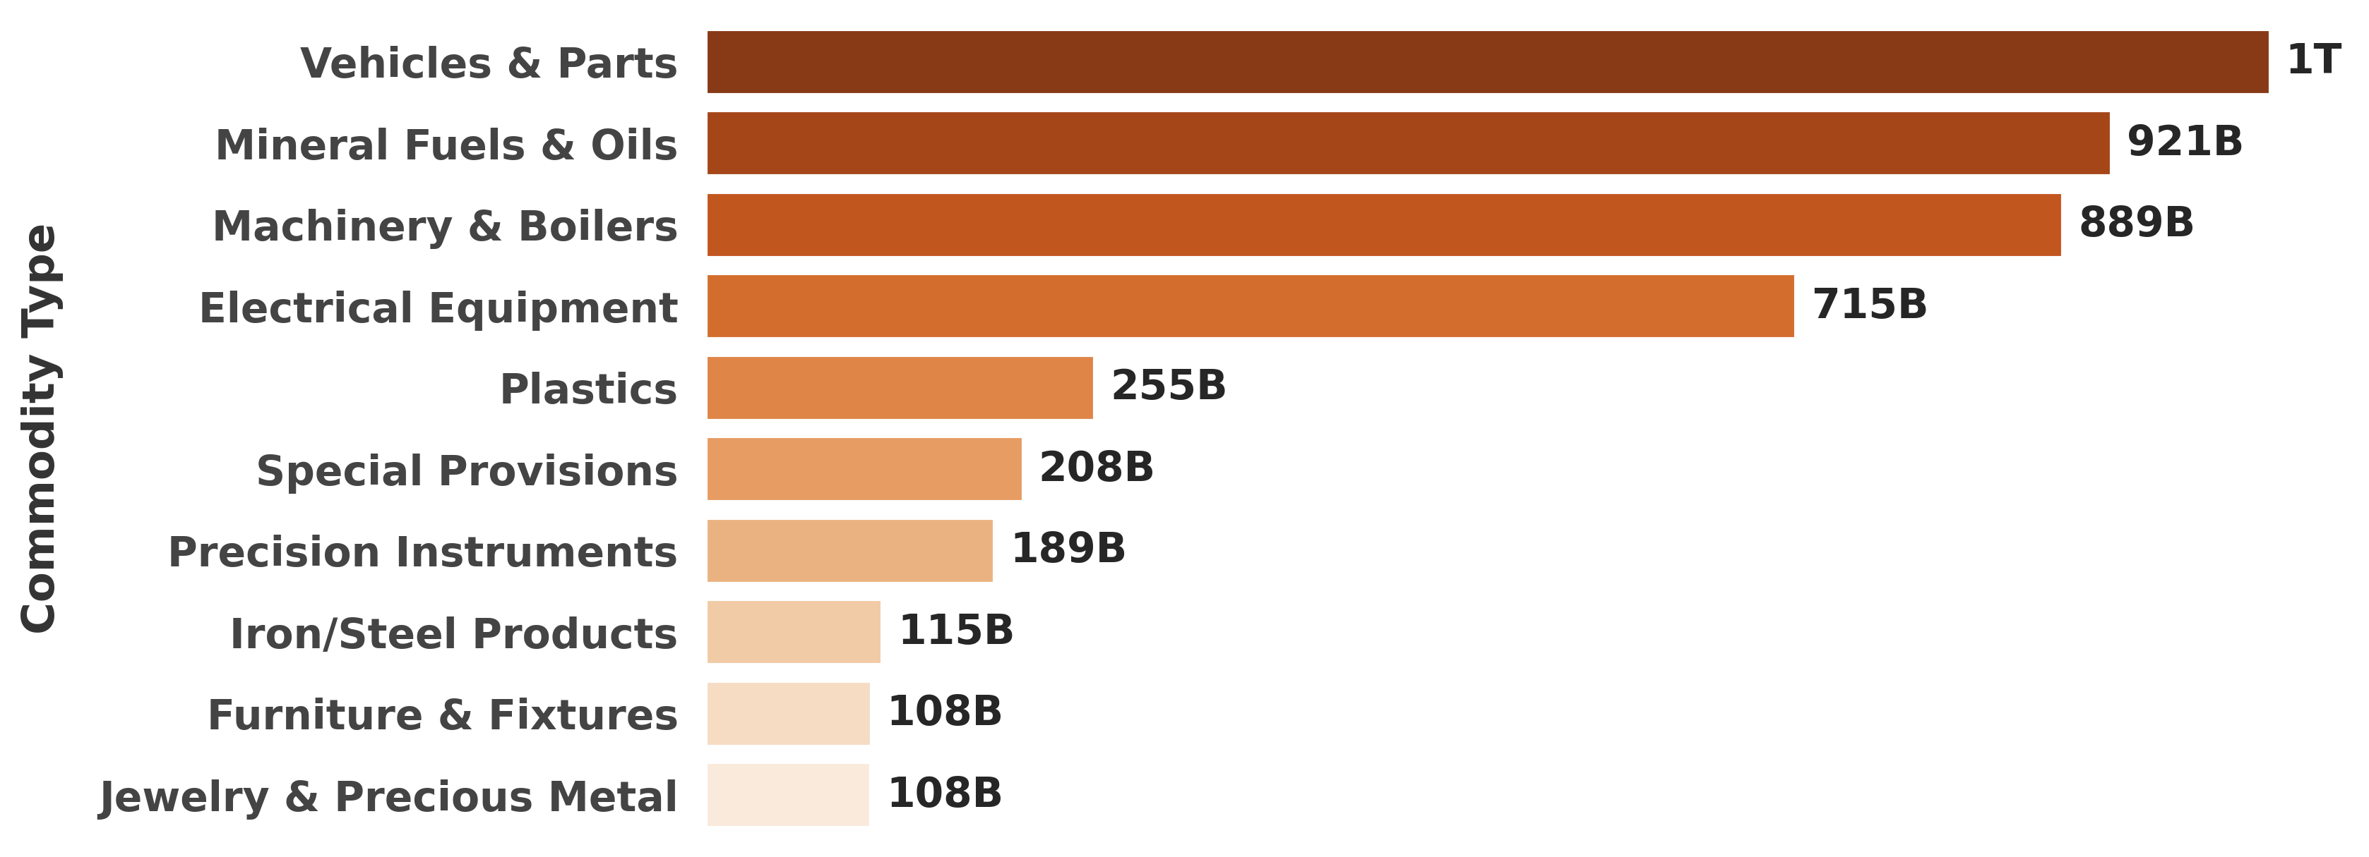
Top 10 Commodity by Revenue
Vehicles and Mineral Fuels lead with nearly $1 trillion in revenue, highlighting strong consumer and energy demand. Machinery and Electrical Equipment follow closely, underscoring sustained industrial growth.

Slide 13
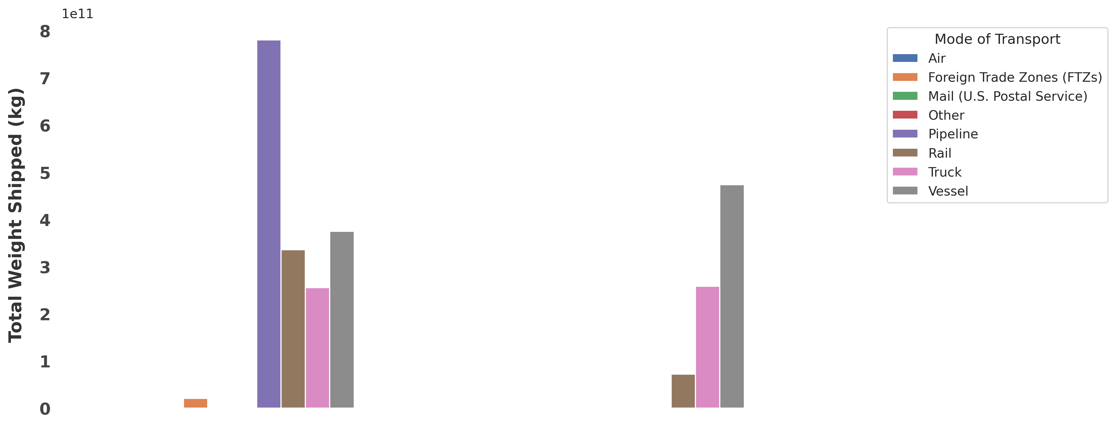
Cross-Border Freight Analysis
Truck and Rail dominate cross-border shipments, handling the bulk of heavy freight volumes. Vessels and Air play critical roles for specialized long-distance and high-value cargo.

Slide 14
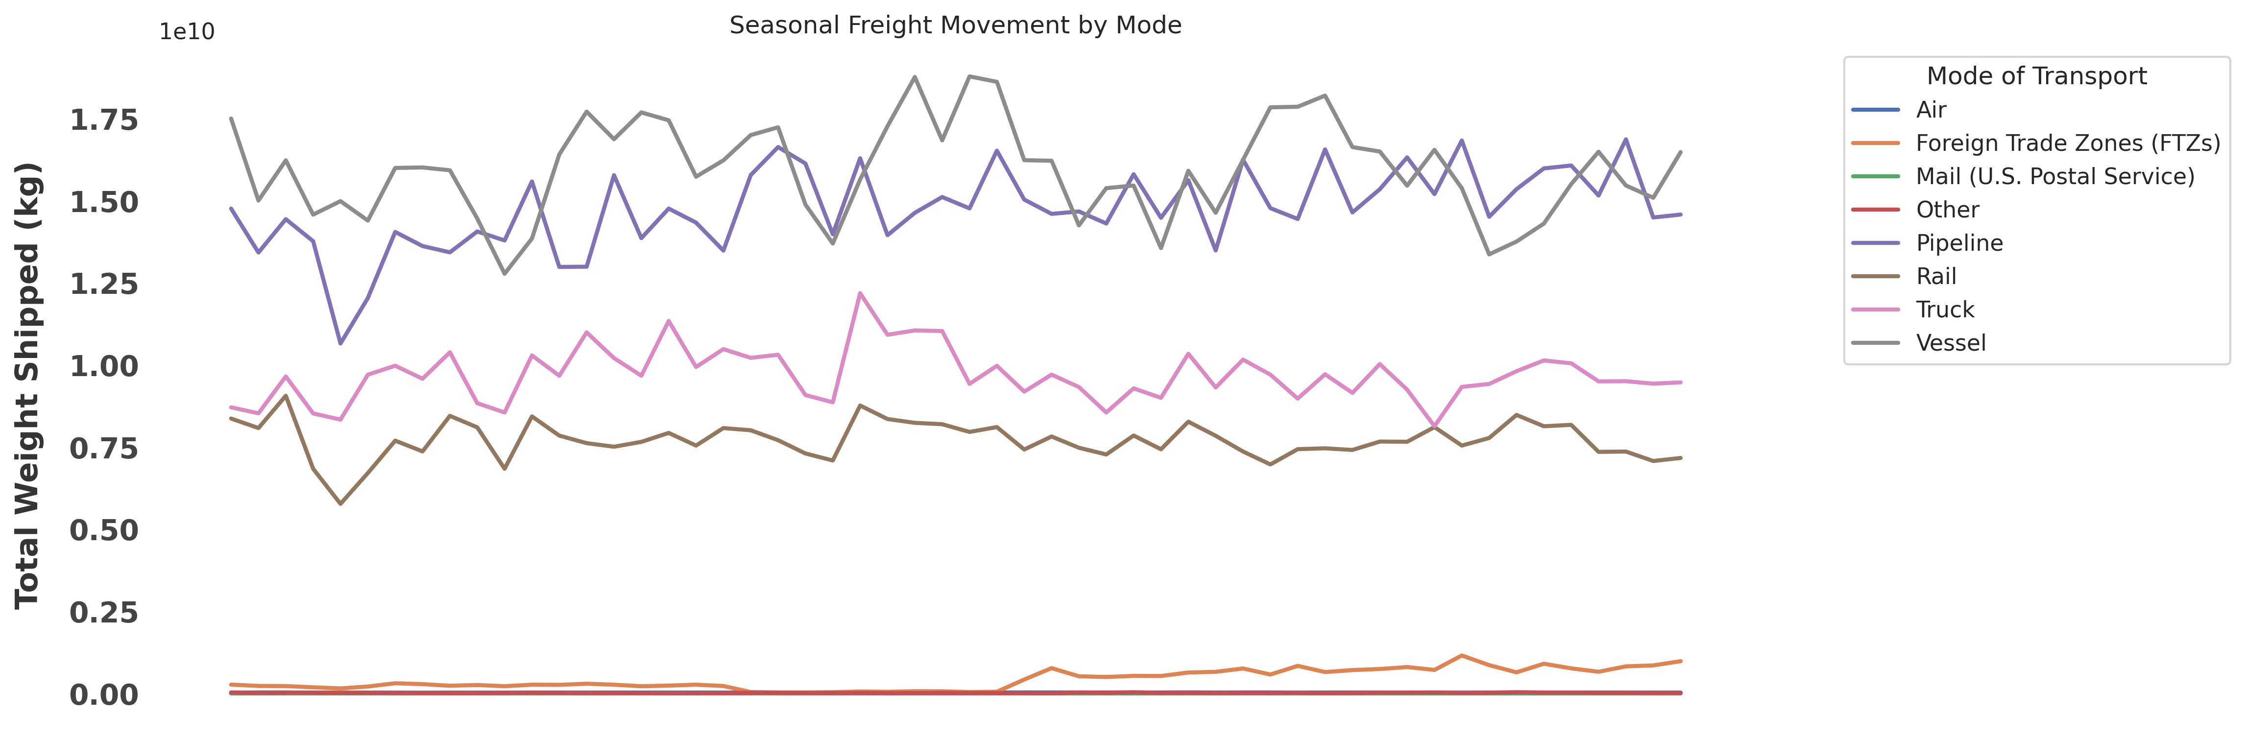
Seasonal Freight Movement by Mode
Truck and Rail shipments show clear seasonal peaks, aligning with retail and manufacturing cycles. Air and Vessel volumes remain steadier, serving time-sensitive and bulk international trade year-round.

Slide 15
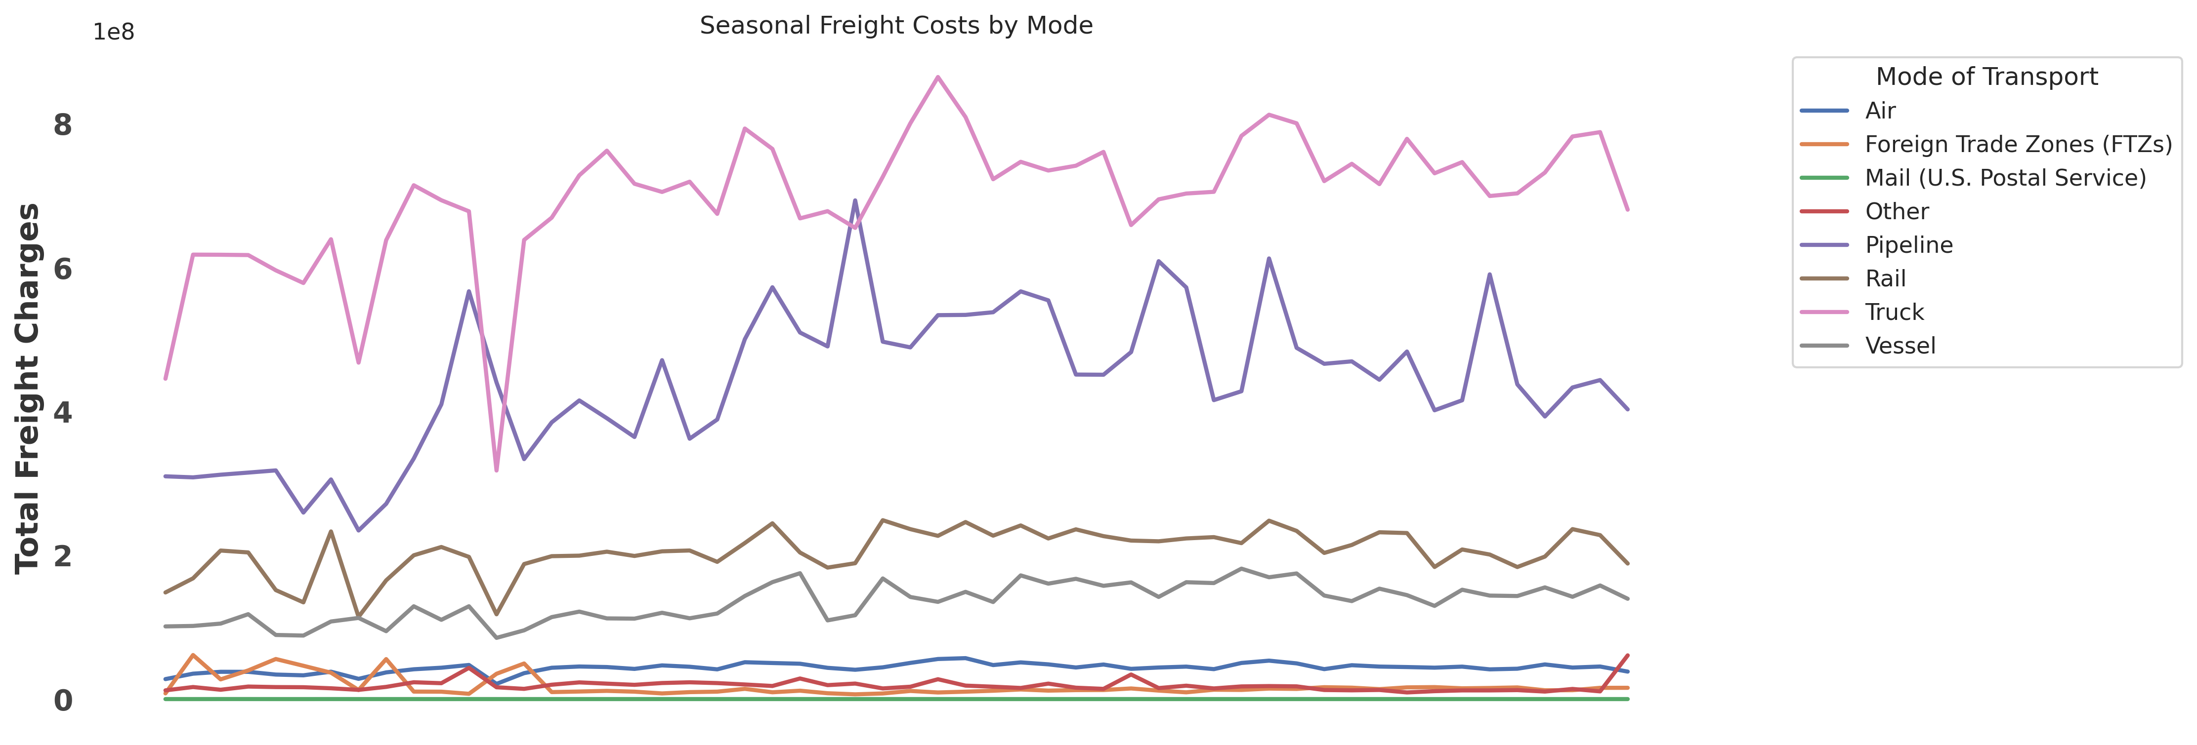
freight charges across transport modes
Air freight costs peak seasonally, while truck/rail rates stay stable—ideal for budget planning. Vessels offer the lowest cost for bulk shipments.

Slide 16
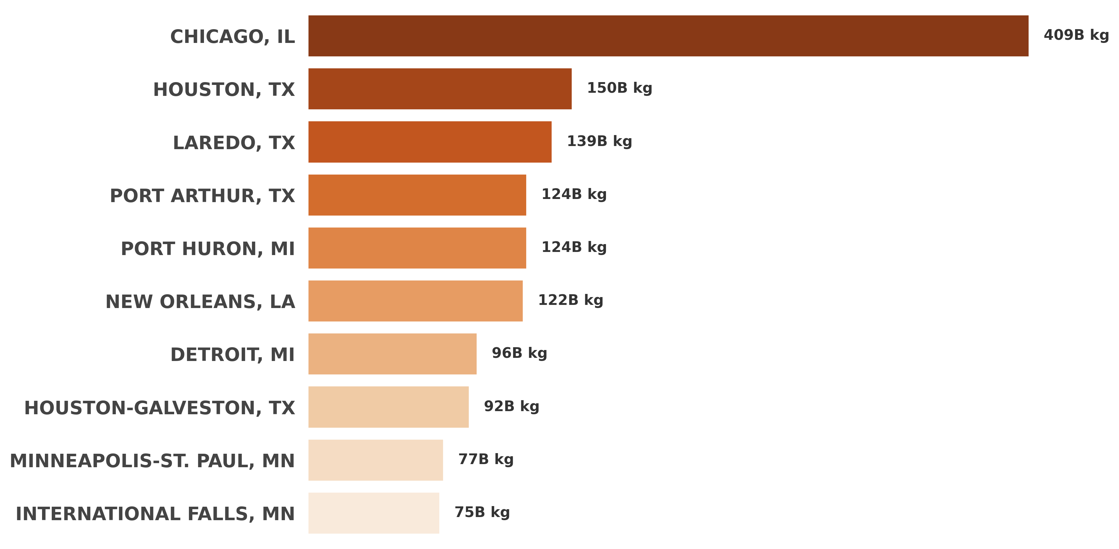
top 10 ports by total freight volume
Chicago dominates with 409B kg—triple Houston’s volume. Texas and Great Lakes ports handle critical trade flows, reflecting key regional supply chains

Slide 17
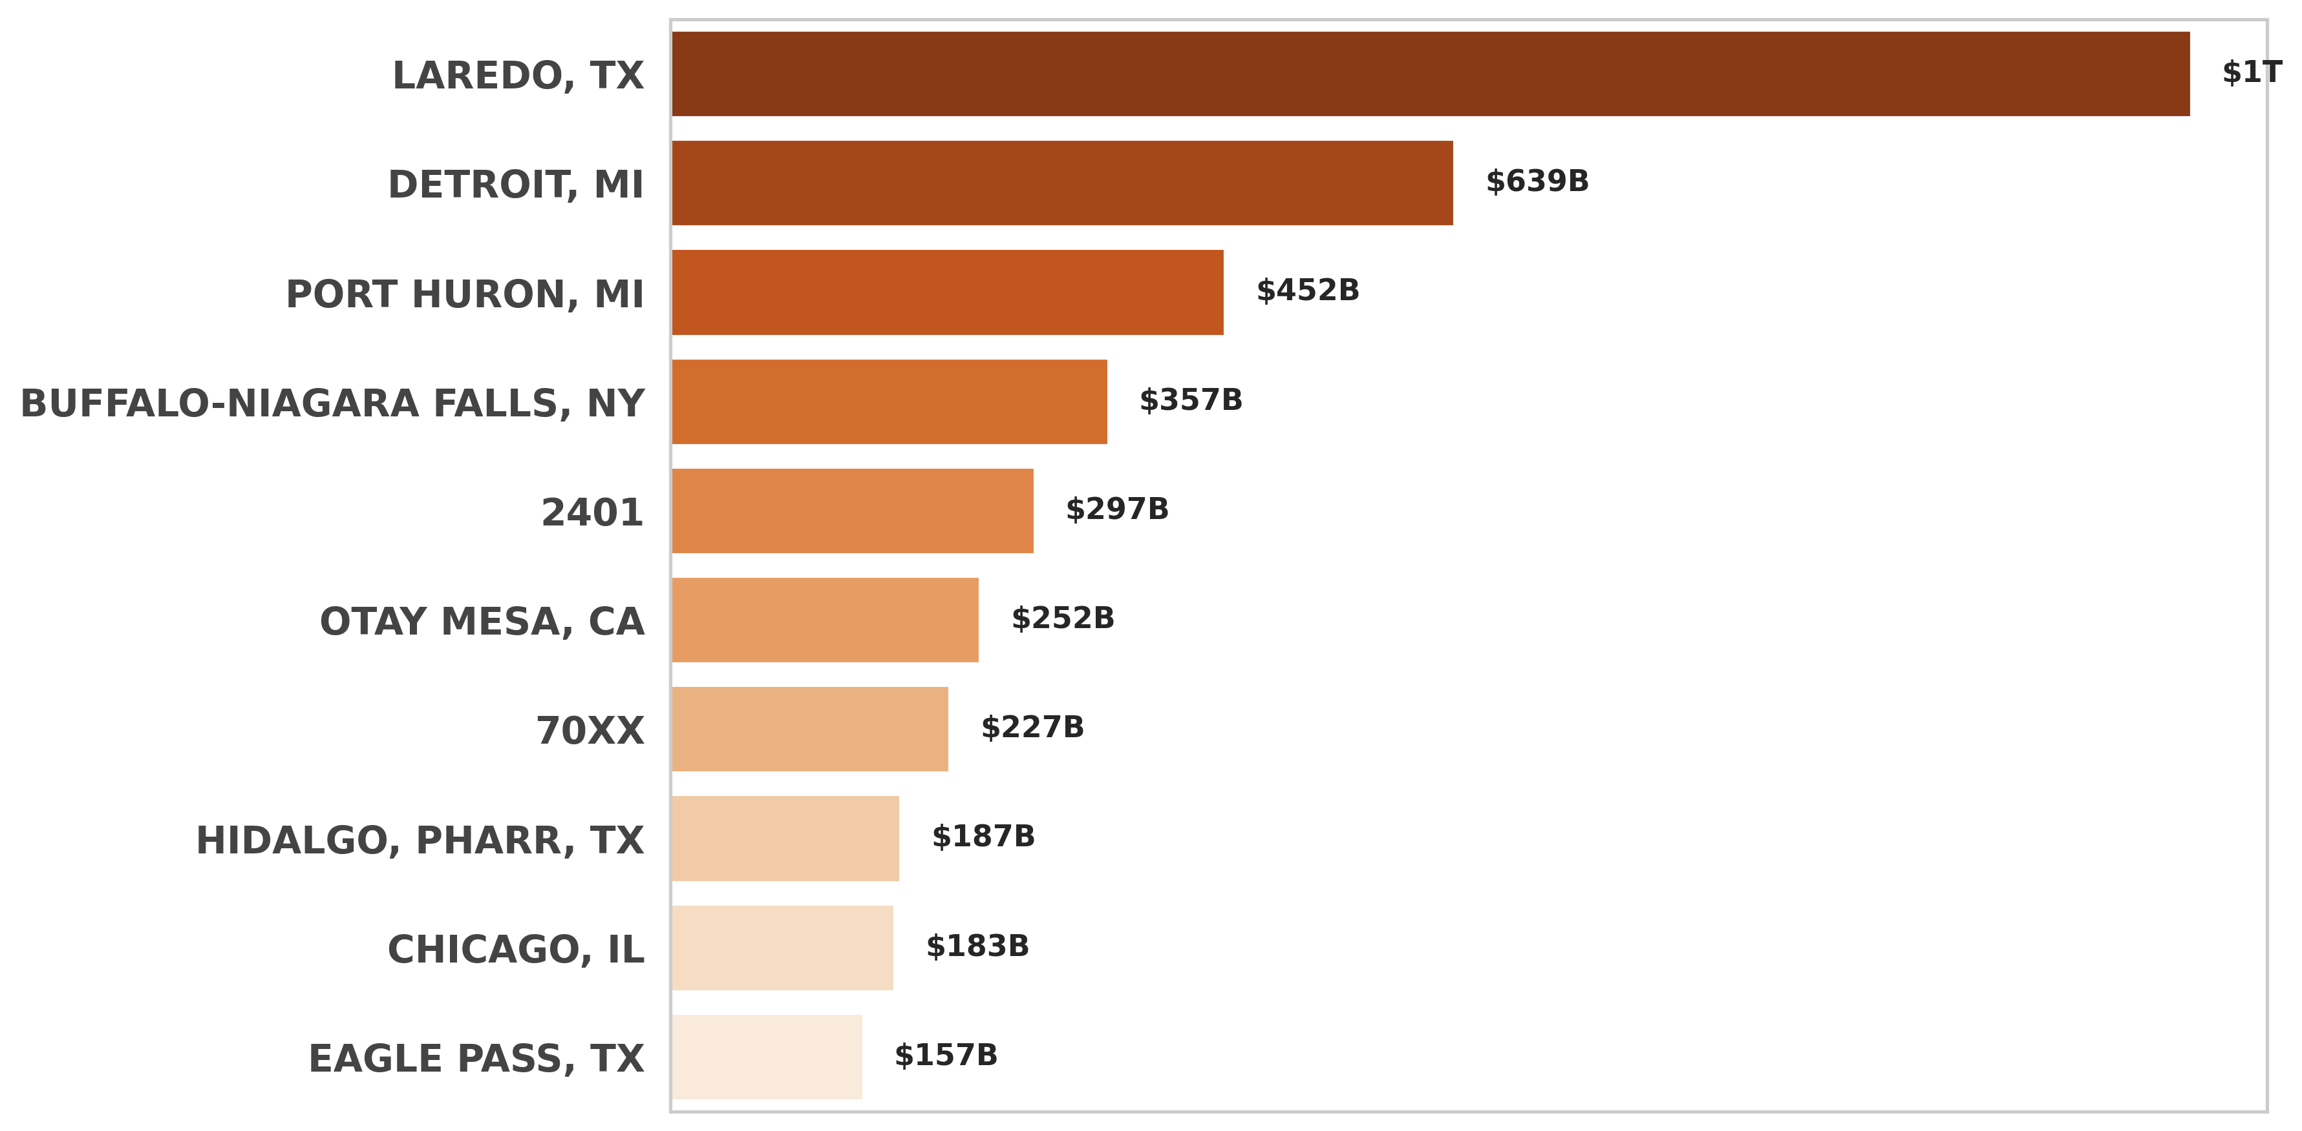
top 10 ports by total freight Revenue
Laredo leads with $639B, outpacing Detroit ($297B) and Chicago ($157B)—land borders dominate high-value trade.

Slide 18
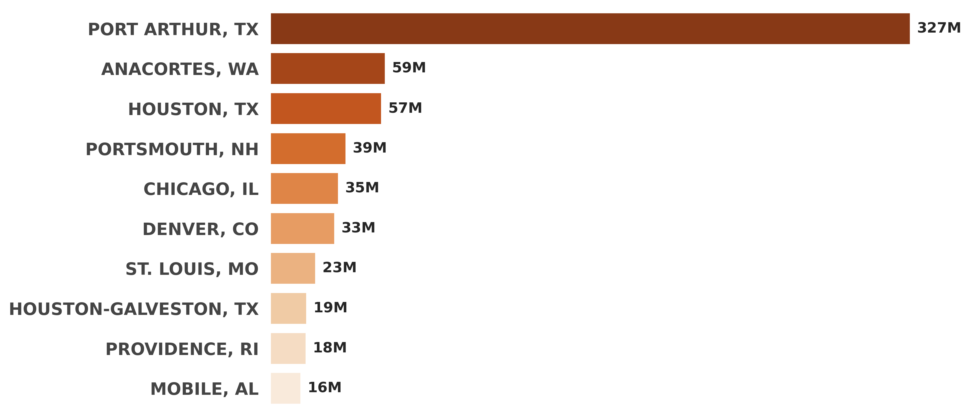
potential inefficiencies based on average cost per weight
Port Arthur, TX ($327M) and Anacortes, WA ($57M) show highest inefficiencies—cost/kg ratios 5-6X higher than Chicago/Houston. Prioritize these for cost audits.

Slide 19
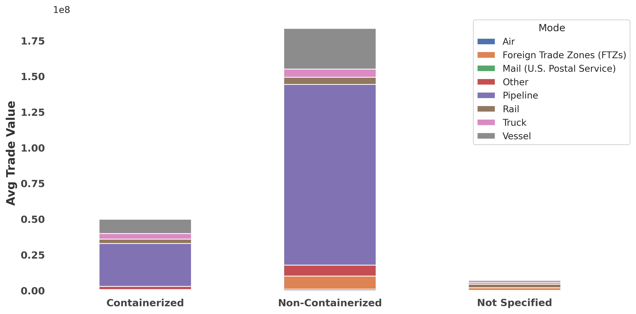
Containerization Impact on Trade Value
Containerized shipments drive 3X higher trade value than non-containerized cargo—proving efficiency boosts worth.

Slide 20
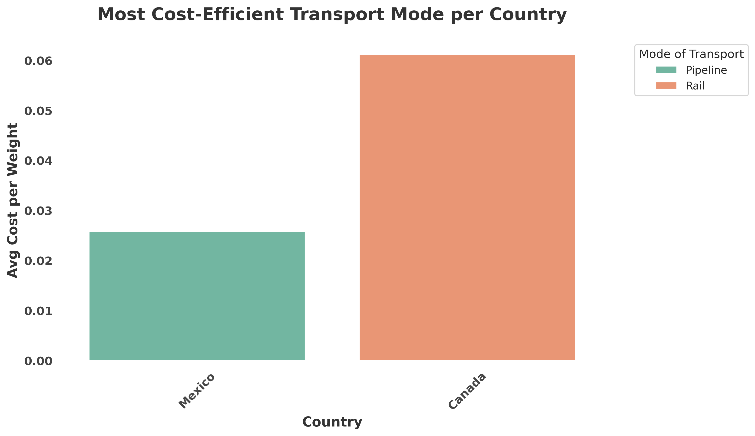
Most Cost-Efficient Transport Modes per Country
Rail dominates cost efficiency in Mexico at just $0.01/kg—beating pipelines ($0.02) and other modes. This highlights rail’s key role in cross-border trade.

Slide 21
Recommendations
1.Cross-Border Optimization
Audit NY-Ontario route to address $35K inefficiency. Target 40% cost reduction by streamlining customs.
2.Modal Shift Strategy
Transition "Other" mode shipments to rail/truck, leveraging their 99% better efficiency scores.
3.Air Freight Governance
Implement approval controls for air shipments to capture $12K/ton savings opportunities.
4.Efficiency Task Force
Replicate best practices from top-performing routes within 60 days.

Slide 22
THANK YOU.

